Slide 1

Community Health Aide Program

Slide 2

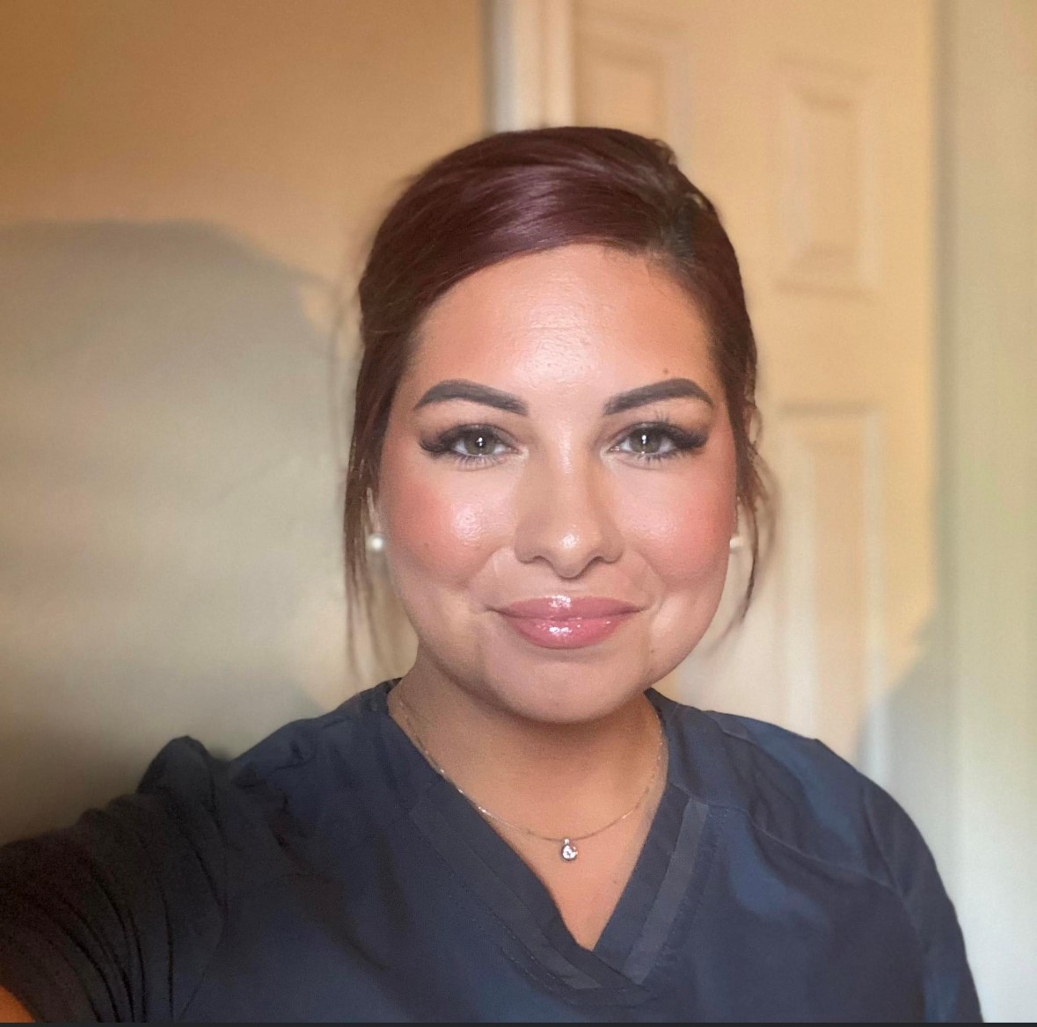


SPTHB CHAP Team
CHAP Program Manager: Julie Seward (Cherokee), RDH, MEd
CHAP Program Coordinator: Kimberlee Burgess (Otoe Missouria), RN
Public Health Specialist: Kynsington Cochran (Kiowa), BS

Slide 3

Objectives
Background and History of the Community Health Aide Program (CHAP)
Provide an understanding of the role of a Community Health Aide/Practitioner, Behavioral Health Aide & Dental Health Aide in Tribal Communities, an outline of the education program, supervision of providers, and benefits of having each discipline serving Tribal Health Organizations and Tribal communities.

Slide 4
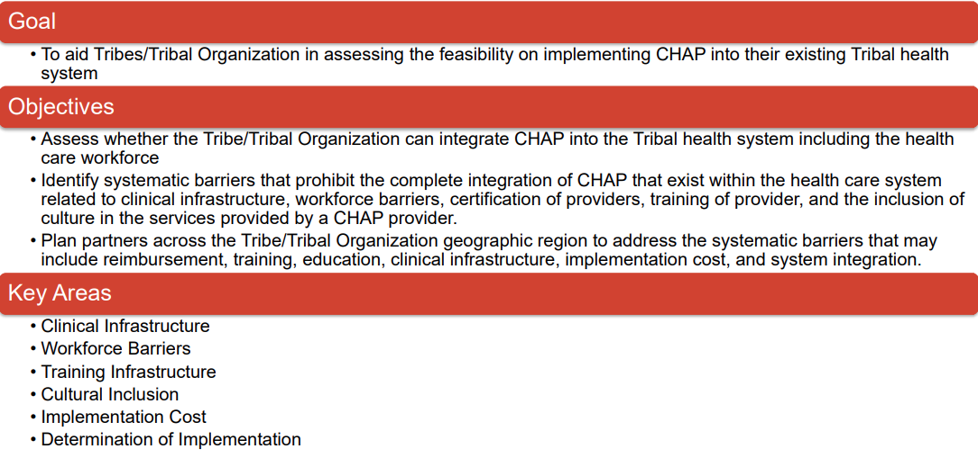

Slide 5
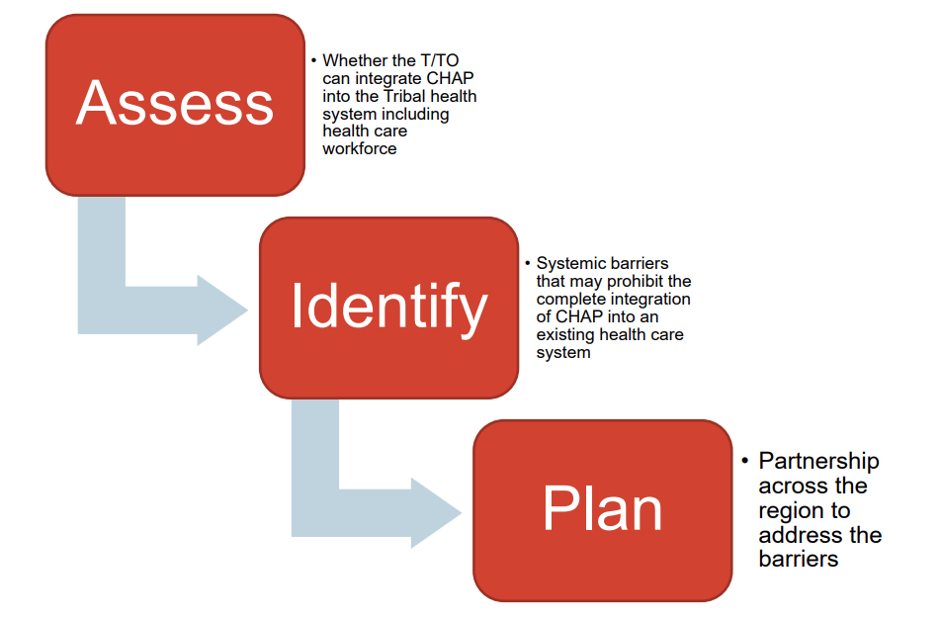

Slide 6
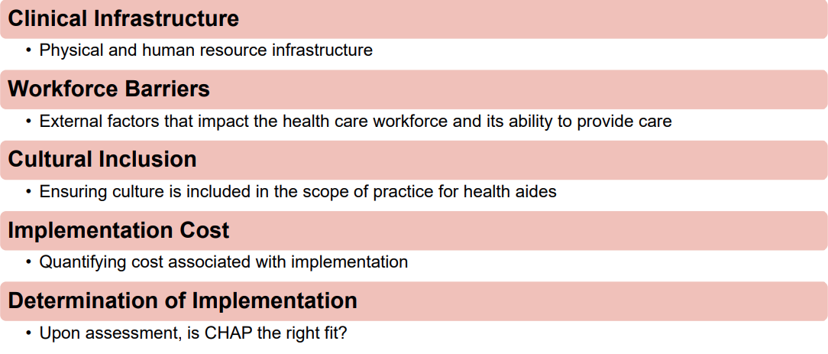

Slide 7
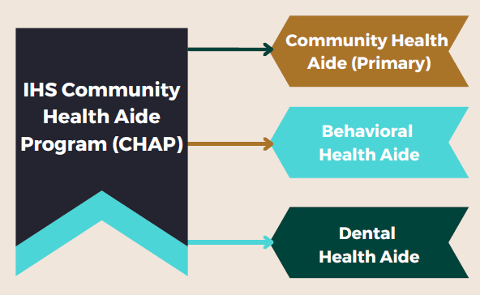

Slide 8
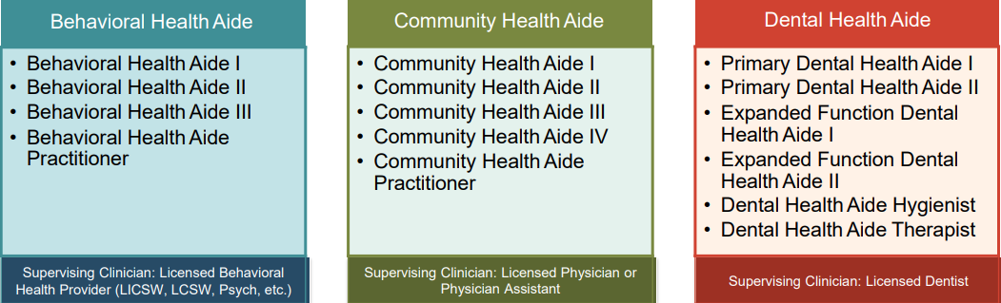
The Community Health Aide Program (CHAP) includes three (3) different health aide provider types, each including a tiered level practice. Health aides do not practice independently, but under the direct/indirect supervision of a licensed clinician. These health aides are seen as extenders of their supervising clinician to provide direct patient care. Because health aides extend the provider, they expand the system of care and increase access to care and have the ability to mobilize healthcare.

Slide 9

Intention
The CHAP Intention was to train local people who were familiar with village life and likely to stay in the community.
Initially "the eyes and ears of the physician," Health Aides have successfully taken on an increasing role in the provision of primary care services and have helped meet rising expectations for health care.
The primary care model used in the Community Health Aide Program has always included:
  Emergency
  Acute
  Chronic care
  Preventive health components

Slide 10

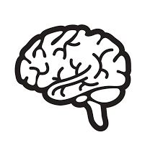

What is the Community Health Aide Program?
DHAs are primary oral health care professionals that can provide clinical dental treatment, patient education and preventative services.
BHAs are counselor’s, health educators, and advocates. BHAs help address individual and community-based health needs such as alcohol, drug and tobacco abuse and mental health. BHAs use a combination of Western and traditional based practices to provide care.
CHA/Ps work with guidelines of the Alaska Community Health Aide/Practitioner Manual (CHAM) to assess and provide emergency, acute and chronic care to residents and their respective rural communities.

Slide 11
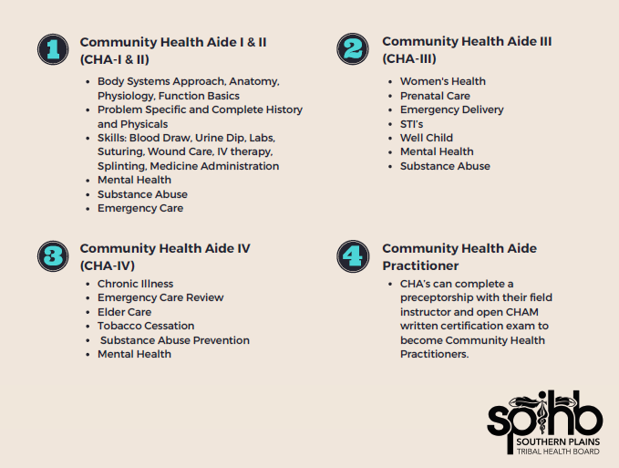

Slide 12
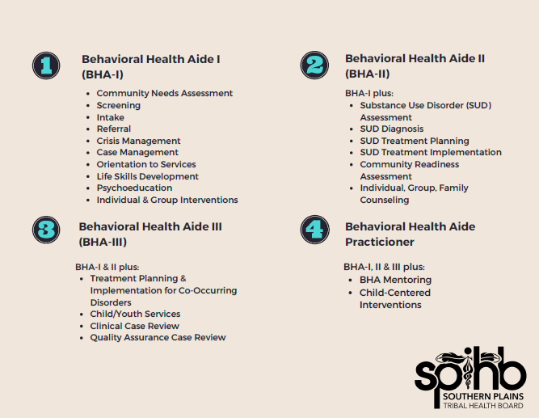

Slide 13
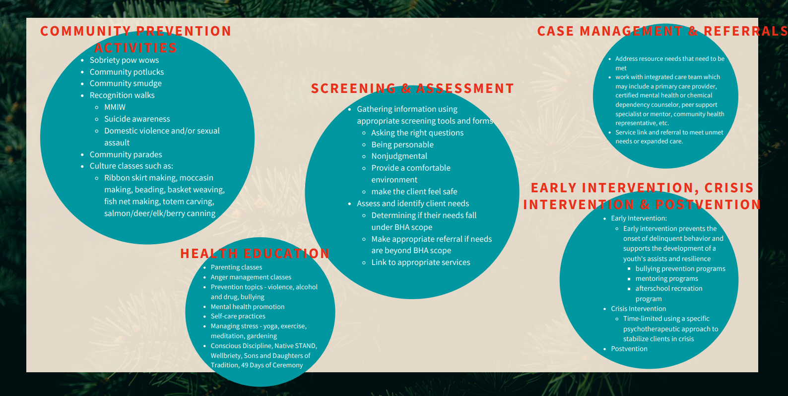

Slide 14
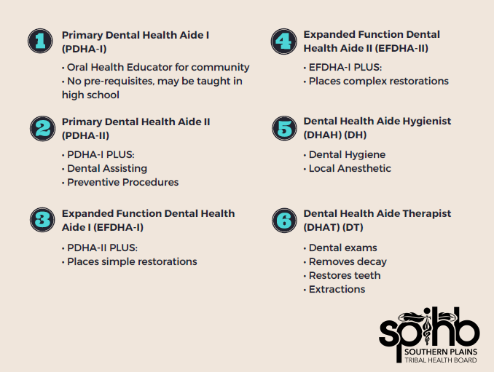

Slide 15
Acknowledgments
Thank you to the Alaska Native Tribal Health Consortium and the Northwest Portland Area Indian Health Board for paving the way for the Community Health Aide Program and partnering with Southern Plains Tribal Health Board to provide your service and guidance!

Slide 16
Resources
  IHS CHAP Site https://www.ihs.gov/chap/
  IHS Community Education https://www.ihs.gov/chap/communityed/
  Recordings:
  https://ihs.cosocloud.com/px4i3z7buo55/ https://ihs.cosocloud.com/pb526qkw7vx0/ https://ihs.cosocloud.com/pdcq0io5mi0z/ https://ihs.cosocloud.com/p3c2z9psoa00/
  CHAP Policy https://www.ihs.gov/ihm/circulars/2020/community-health-aide-program/
  CHAP TAG Charter https://www.ihs.gov/ihm/circulars/2018/community-health-aide-program-tribal-advisory-group-charter/

Slide 17
Resources
Alaska CHAP Sites
https://akchap.org/
https://www.anthc.org/
Northwest Portland CHAP Sites
https://www.npaihb.org/
https://www.tchpp.org/

Slide 18
Questions?
Thank you for your time!

