Slide 1
Community Health Aide Program

Slide 2
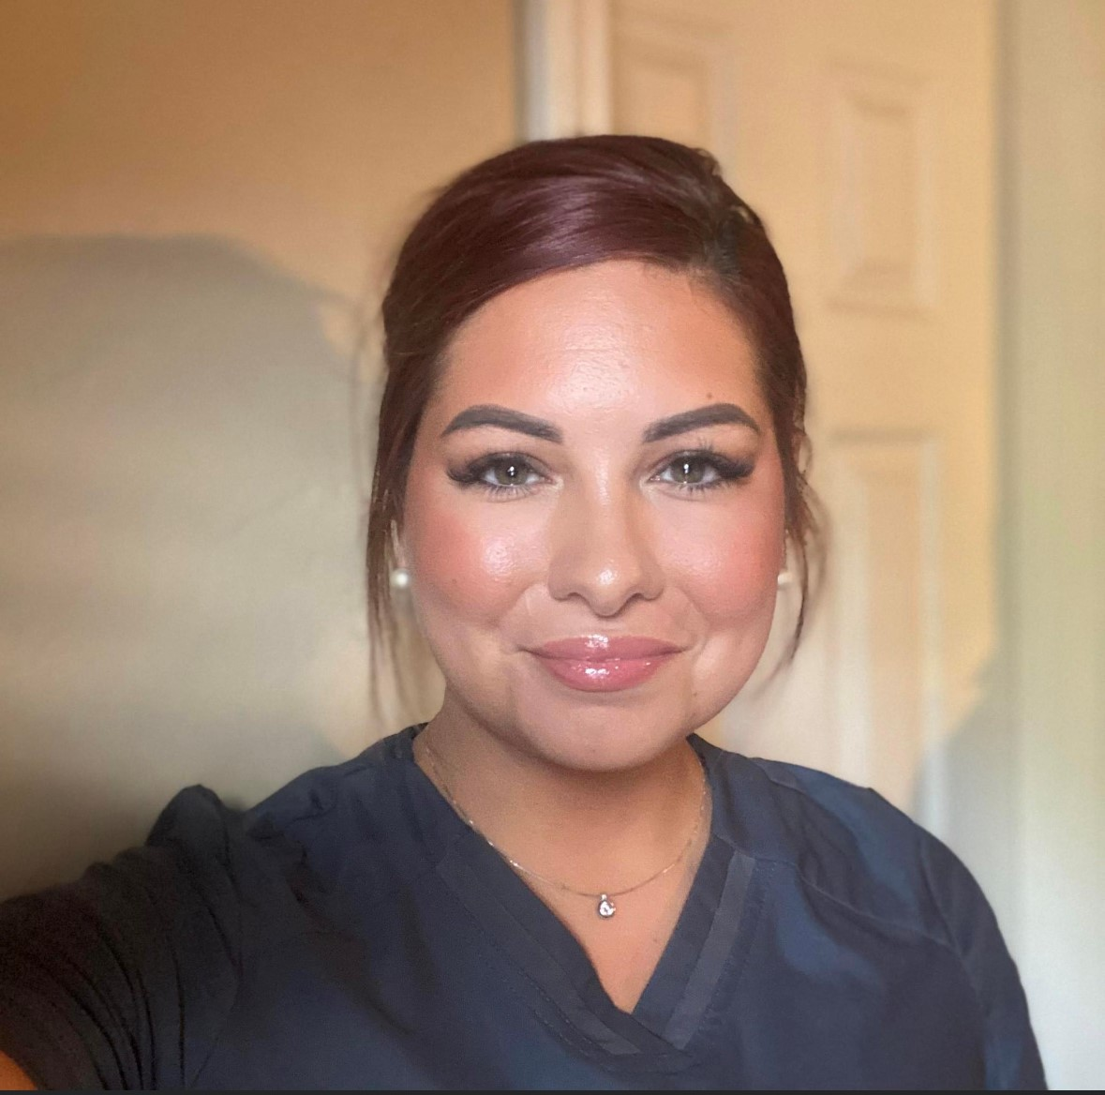
SPTHB CHAP Team
CHAP Program Manager: Julie Seward (Cherokee), RDH, MEd
CHAP Program Coordinator: Kimberlee Burgess (Otoe Missouria), RN
Public Health Specialist: Kynsington Cochran (Kiowa), BS

Slide 3
Objectives
Background and History of the Community Health Aide Program (CHAP)
Provide an understanding of the role of a Community Health Aide/Practitioner, Behavioral Health Aide & Dental Health Aide in Tribal Communities, an outline of the education program, supervision of providers, and benefits of having each discipline serving Tribal Health Organizations and Tribal communities.

Slide 6
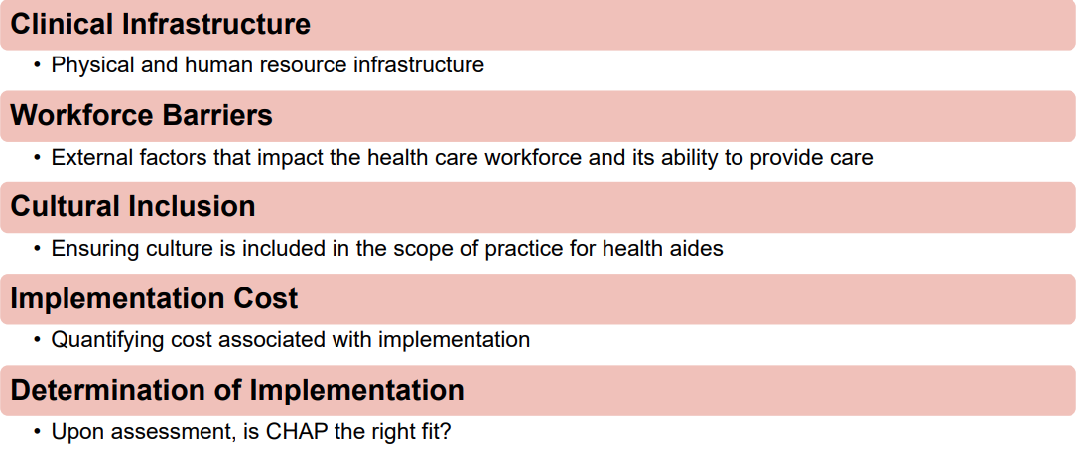

Slide 7
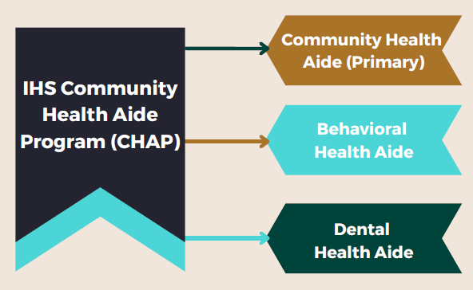

Slide 8
The Community Health Aide Program (CHAP) includes three (3) different health aide provider types, each including a tiered level practice. Health aides do not practice independently but under the direct/indirect supervision of a licensed clinician. These health aides are seen as extenders of their supervising clinician to provide direct patient care. Because health aides extend the provider, they expand the system of care and increase access to care and have the ability to mobilize healthcare.

Slide 9
Background

Slide 10
Intention
The CHAP Intention was to train local people who were familiar with village life and likely to stay in the community.
Initially "the eyes and ears of the physician," Health Aides have successfully taken on an increasing role in the provision of primary care services and have helped meet rising expectations for health care.
The primary care model used in the Community Health Aide Program has always included:
Emergency
Acute
Chronic care
Preventive health components

Slide 11
What is the Community Health Aide Program?
DHAs are primary oral health care professionals that can provide clinical dental treatment, patient education, and preventative services.
BHAs are counselors, health educators, and advocates. BHAs help address individual and community-based health needs such as alcohol, drug, and tobacco abuse, and mental health. BHAs use a combination of Western and traditional based practices to provide care.
CHA/Ps work with guidelines of the Alaska Community Health Aide/Practitioner Manual (CHAM) to assess and provide emergency, acute and chronic care to residents and their respective rural communities.

Slide 12
Program History

Slide 13
Program History
The program originates from the TB epidemic in the 1950s.
Volunteer chemotherapy aides gave out oral medicines in the village under the remote supervision of a physician. People continued to seek health care and advice through these village aides after the outbreak ended.
In the 1960s, more formal training was gradually offered, and the CHA Program began to take form.
In 1968 the Alaska Community Health Aide Program was recognized and funded by Congress. Training and responsibilities have grown tremendously since then.

Slide 14
Timeline
1st Event | 2nd Event | 3rd Event | 4th Event | 5th Event | 6th Event
1976 | 1998 | 2004 | 2009 | 2013 | 2020
First Community Health Aide Manual (CHAM) was created. | Alaska Community Health Aide Program Certification Board (CHAPCB) was formalized with training and practice standards and procedures. | First Dental Health Aides (in AK) were certified. | First Behavioral Health Aides (in AK) were certified. | Electronic Community Health Aide Manual (eCHAM) was released and officially replaced the paper CHAM. | Nationalization of the CHAP program was approved.

Slide 15
Community Health Aide (CHA/P Primary Care)

Slide 16
CHA/P Role
Trained to see patients independently, under the supervision of a Physician or Advanced Practice Provider Proxy (Physician Associate, Nurse Practitioner).
Trained on the medical model of History, Physical Exam, and Assessment plan.
Make assessments, not diagnoses.
Use the Community Health Aide Manual (CHAM) for every patient visit.
Dispense but do not prescribe medications.
Eligible for standing orders

Slide 17
CHA/P Requirements
In Alaska, Community Health Aides are selected and hired by local Tribal Health Organizations before training, but in the Southern Plains Region, the process for attending training may look different.
Generally, they should:
Live in the community while employed as a CHA/P.
Read and write English and perform math (including decimals and fractions) at a 6th-grade minimum level.
Be willing to leave home to attend training.

Slide 18
CHA/P Workload
Typically employed to:
See one patient per hour.
They can be expected to work
after hours, weekends, holidays.
They can be expected to see
patients in clinics with:
Physicians
Advanced Practice Providers
Other CHAPs
Sole Providers
Could be employed to:
Increase provider availability during regular clinic hours.
Extend clinic hours (evenings, weekends)
Provide overnight coverage to reduce ER visits.
Provider relief (rotate through different clinics so others get their PTO, maternity leave, etc.)
Open additional clinics in communities.

Slide 19
Education and Practice Logistics

Slide 20
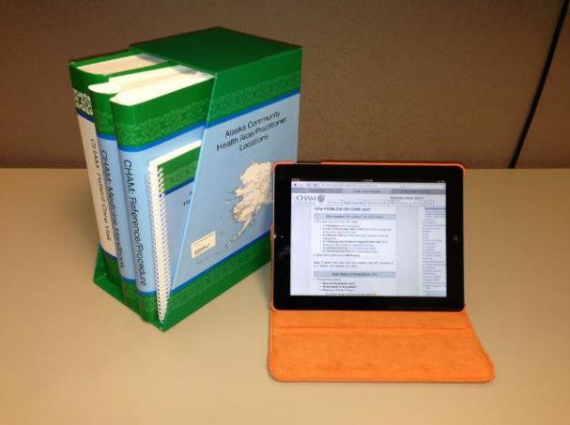
The CHAM
A guide to the CHA/P for every patient encounter
Identifies specific sections to guide history, exam, and determine assessment
Follows a specific plan, report
Available:
Online: eCHAM Website
Offline: iCHAM (iPad app)
Personalization features
Bookmarks, comments, highlights.
Regional Notes

Slide 21
Becoming a CHA/P
Pre-Requisite
Students must have a high school diploma or equivalent
Must meet reading and math minimums to be accepted into CHAP Program.
The Program
Takes approximately two years to complete all educational sessions and become a Community Health Practitioner

Slide 22
Process
1. Pre-Session - Students attend a
one week pre-session
2. Education consists of FOUR
sessions, each 3-4 weeks long and
includes didactic and clinical
education
3. Post session - Requirements
include specific numbers and types
of patients to be seen at home or in
clinics before the next session
4. Preceptorship - CHA-IV’s attend a
2-week preceptorship and take an
open book certification exam to
become a community health
practitioner

Slide 23
Education Program
Pre-Session
1-2 weeks of education on Tribal Health Organization policies, use of the CHAM, introduction to the CHA/P role and patient care, emergency training
CHA/P Basic Education
Consisting of four sessions, each one 3-4 weeks long, at a certified education center staffed by instructors, typically PAs, NPs, and physicians. Between each session, CHA/Ps return to their home clinics to see certain numbers and types of patients along with meeting post-session learning needs under the auspice of their field instructors.
Upon completion of all sessions and education requirements
CHAs can complete a preceptorship with their field instructor and open CHAM written certification exam to become Community Health Practitioners.

Slide 24
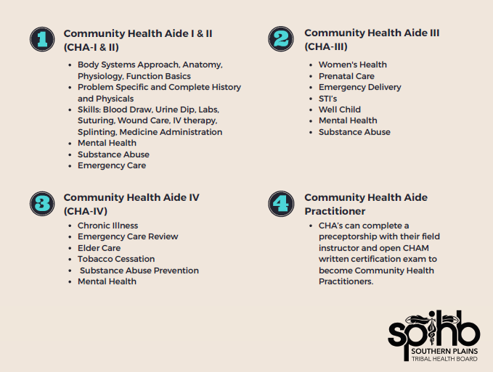

Slide 25
CHA/P Maintenance
To maintain credentials, the CHA/P must:
• Complete approved continuing medical education (CME) regularly
• Renew emergency training regularly
• Retake the CHA/P credentialing exam and preceptorship at regular intervals

Slide 26
Supervising CHA/Ps

Slide 27
Role of Referral Provider
Provides clinical supervision during patient care
Each Community Health Aide/Practitioner works under the medical supervision of a licensed physician. It is the physician’s medical oversight that enables the CHA/P to practice.
Referral provider may be a physician, nurse practitioner, or a physician associate
Provides clinical training and assistance to CHA/Ps
Provides regular chart reviews.
Observe patient visits with the CHA/P
Be prepared to provide consultation to the CHA/P regarding skills and Standing Orders
Be familiar with the tribal health organization operations

Slide 28
Referral Providers Supporting CHA/Ps
Should be familiar with the program, training, and documents used.
Follow the guidelines in the Health Aide Manual when they train CHA/Ps or take reports from them.
Support the CHA/Ps medical assessments based on this Manual and regional guidelines.
Talk with the CHA/P regularly

Slide 29
Role of Tribal Health Organization
Determine how you will employ CHA/Ps in your clinics/facilities
Create positions and hire CHA/Ps
Provide Physician and/or Advance Practice Provider (APP) for supervision, education, and take CHA/P patient report
Arrange for day-to-day supervision, direction, and support for the CHA/Ps in several different ways
Provide compensation and benefits to CHA/Ps
Allow support staff to participate in various CHA/P Program Boards and Committees

Slide 30
Benefits of CHA/P Integration

Slide 31
Important Factors in Employing CHA/Ps
Creating jobs in your communities for your community members
Keeping talent in your communities rather than having them be drawn out of the community
Ideal CHAP Candidates
HS diploma or equivalent
Desire to serve the community
Ensure you have the capacity to provide CHA/P oversight by a Physician or Advance Practice Provider

Slide 32
Ideas for CHA/P Clinic Integration
CHA/Ps Can Do:
Acute Care visits
Basic Chronic Care visits
Well and Sick Child visits
Elder Care clinic and home visits
Wound Care visits
Prenatal Care visits
STI clinics
Vaccination clinics
Extending clinic hours
Providing on call-services
Seeing after-hours acute visits/phone
consultation to reduce ER visits
CHA/Ps Cannot Do:
Sports physicals
Interpret complex lab results, but can evaluate basic labs (U/A’s, strep tests, pregnancy tests, etc.)

Slide 33
Clinic Improvements from CHA/Ps
Increase patient access to healthcare in Tribal communities
Reduce workload on other healthcare providers that may focus time on more complex patient issues and quality improvement efforts
Improved continuity of care in the community
Recruit and train from within:
Creating jobs in communities will economically benefit the region
Career opportunities that keep talent in your communities

Slide 34
Community Benefits of CHA/Ps
Increased career options within the community
Career advancement opportunities created for community members that allow them to remain in their communities for most of their training
Opening options to parents and caregivers
New possibilities for clinic offerings with additional staffing
Additional services
Extended hours
Increased likelihood of filling open healthcare provider positions in the community
Community benefits of being cared for by a fellow community member

Slide 35
Behavioral Health Aide Program

Slide 36
What is a BHA?
A counselor, health educator, and advocate. BHAs help address individual and community-based behavioral health needs, including those related to alcohol, drug, and tobacco abuse, as well as mental health problems such as grief, depression, suicide, and related issues.

Slide 37
Timeline
1st Event | 2nd Event | 3rd Event | 4th Event | 5th Event | 6th Event
1976 | 1998 | 2004 | 2009 | 2013 | 2020
First Community Health Aide Manual (CHAM) was created. | Alaska Community Health Aide Program Certification Board (CHAPCB) was formalized with training and practice standards and procedures. | First Dental Health Aides (in AK) were certified. | First Behavioral Health Aides (in AK) were certified. | Electronic Community Health Aide Manual (eCHAM) was released and officially replaced the paper CHAM. | Nationalization of the CHAP program was approved.

Slide 38
Timeline Continued
In the early 1990s, Alaska began establishing a need for a Behavioral Health Aide model.
Alaska legislature established the Rural Human Services System Project and funded village-based counselors in 40 villages.
In the early 2000s, IHS funds were provided by Congress to develop a Behavioral Health Aide Program in Alaska, in 2009, the process for establishing and certifying BHAs, in Alaska was fulfilled, and the first BHA was certified.
In 2016, the Community Health Aide Program expanded to other IHS areas.

Slide 39
BHA Role and Service
Who do they serve?
Elders, youth, families, and individuals
What are similar roles?
Peer Recovery Mentors, Peer Support Specialists, Traditional Health Workers, Community Health Workers/Representatives

Slide 41
Who can be a BHA?
Natural Helpers and Advocates that crave to tie in cultural activities into their day-to-day work.
Counselors' good listeners, empaths, aunties/uncles, and storytellers.
Community & Tribal Members homegrown collective committed to serving a Tribal. community
Holistic Caregivers & Healers who would like to utilize Tribal traditional practices.

Slide 42
Education and Practice Logistics

Slide 43
Certification
CHAP National Certification Board: Outlines the minimum program standards for all CHAP Provider types Chaired by the IHS Chief Medical Officer Made up of representatives of the area certification boards
2,000 work experience hours = 1 year of work under a Clinical Supervisor
Completed coursework at chosen Institution
200 practicum hours

Slide 45
Benefits of BHA Integration

Slide 46
BHA Benefits
Behavioral Health Aides/Practitioners are educated in traditional healing/spiritual healing as mentored by Tribal respected practitioners, providing holistic care for their community.
BHAs seek to achieve balance in the community by integrating their sensitivity to cultural needs with specialized training in behavioral health concerns and approaches to treatment.

Slide 47
Dental Health Aide Program

Slide 48
What is a Dental Health Aide?
Primary oral health care providers that deliver routine and preventive care under the supervision of a dentist.
• Primary oral health care
professionals
• Basic clinical dental treatment
and preventive services
• Multidisciplinary team members
• Advocate for the needs of clients
• Refer for services beyond the
scope of the dental therapist’s
practice.

Slide 49
DHA Mission
Connect tribal communities with innovative approaches to address AI/AN oral health disparities, to remove barriers impeding the creation of efficient, high-quality, modern dental teams, and to provide opportunities for AI/AN people to become oral health providers. There is a tremendous opportunity to increase access to oral health care and improve oral health outcomes by training and employing Dental Health Aide Therapists (DHATs). DHATs are highly-trained primary oral health care providers. Part of a dentist-led team, they have a narrow scope of practice, focusing on routine and preventive services. They are recruited from their communities and go back to serve their communities. Tribes deserve the reliable, culturally relevant care that DHATs offer.

Slide 50
Timeline
1st Event | 2nd Event | 3rd Event | 4th Event | 5th Event | 6th Event
1976 | 1998 | 2004 | 2009 | 2013 | 2020
First Community Health Aide Manual (CHAM) was created. | Alaska Community Health Aide Program Certification Board (CHAPCB) was formalized with training and practice standards and procedures. | First Dental Health Aides (in AK) were certified. | First Behavioral Health Aides (in AK) were certified. | Electronic Community Health Aide Manual (eCHAM) was released and officially replaced the paper CHAM. | Nationalization of the CHAP program was approved.

Slide 51
Timeline Continued
Dental therapists were first introduced to the United States over 15 years ago by a consortium of Alaska Native tribal health organizations. Thanks to their leadership and courage, over 40,000 Native Alaskans now have access to regular dental care for the first time. Dental therapists are community-based health providers that are recruited from their communities and go back to serve their communities.

Slide 52
What services do DHAs Provide?
Educating patients about oral health and prevention
Performing dental evaluations
Giving fluoride treatments
Placing sealants
Cleaning teeth
Placing fillings
Performing simple extractions

Slide 53
Education and Practice Logistics

Slide 54
DHA Scope of Practice
Diagnosis and Treatment
Planning
Prevention
Basic Hygiene
Radiographs
Infection Control
Restorative
Referral Process
Pediatric​
Urgent Care ​
Extractions ​
Community Projects​
Clinic Management​
Equipment Repair and Maintenance​

Slide 55
Education Requirements
2 calendar years of education
No prerequisites
Limited scopes
Dental School texts
Dentist led team
Prevention oriented
Accessible to students
Cultural Competence
Patient-centered

Slide 57
Certification
After coursework-
Preceptorship
Direct supervision
Standing orders-
Limits for general supervision
Recertification-
Every two years
CDE- 24 hours
Direct observation of all
technical skills in scope.

Slide 58
Benefits of DHA Integration

Slide 59
DHA Benefits
Tribal communities have benefited from the reliable, culturally competent care dental therapists offer. Where dental therapists are practicing in tribal communities see:
Expanded access to consistent, routine, high-quality oral healthcare
More AI/AN oral health care providers in professional wage jobs
A more efficient and effective oral health team that brings care where it is needed most, inside and outside of the clinic
Cost-effective solutions for clinics striving to maximize care on limited budgets

Slide 60
Acknowledgments
Thank you to the Alaska Native Tribal Health Consortium and the Northwest Portland Area Indian Health Board for paving the way for the Community Health Aide Program and partnering with Southern Plains Tribal Health Board to provide your service and guidance!

Slide 61
Resources
IHS CHAP Site https://www.ihs.gov/chap/
IHS Community Education https://www.ihs.gov/chap/communityed/
Recordings:
https://ihs.cosocloud.com/px4i3z7buo55/ https://ihs.cosocloud.com/pb526qkw7vx0/ https://ihs.cosocloud.com/pdcq0io5mi0z/ https://ihs.cosocloud.com/p3c2z9psoa00/
CHAP Policy https://www.ihs.gov/ihm/circulars/2020/community-health-aide-program/
CHAP TAG Charter https://www.ihs.gov/ihm/circulars/2018/community-health-aide-program-tribal-advisory-group-charter/

Slide 62
Resources
Alaska CHAP Sites
https://akchap.org/
https://www.anthc.org/
Northwest Portland CHAP Sites
https://www.npaihb.org/
https://www.tchpp.org/

Slide 63
Questions?
Thank you for your time!

